Slide 1

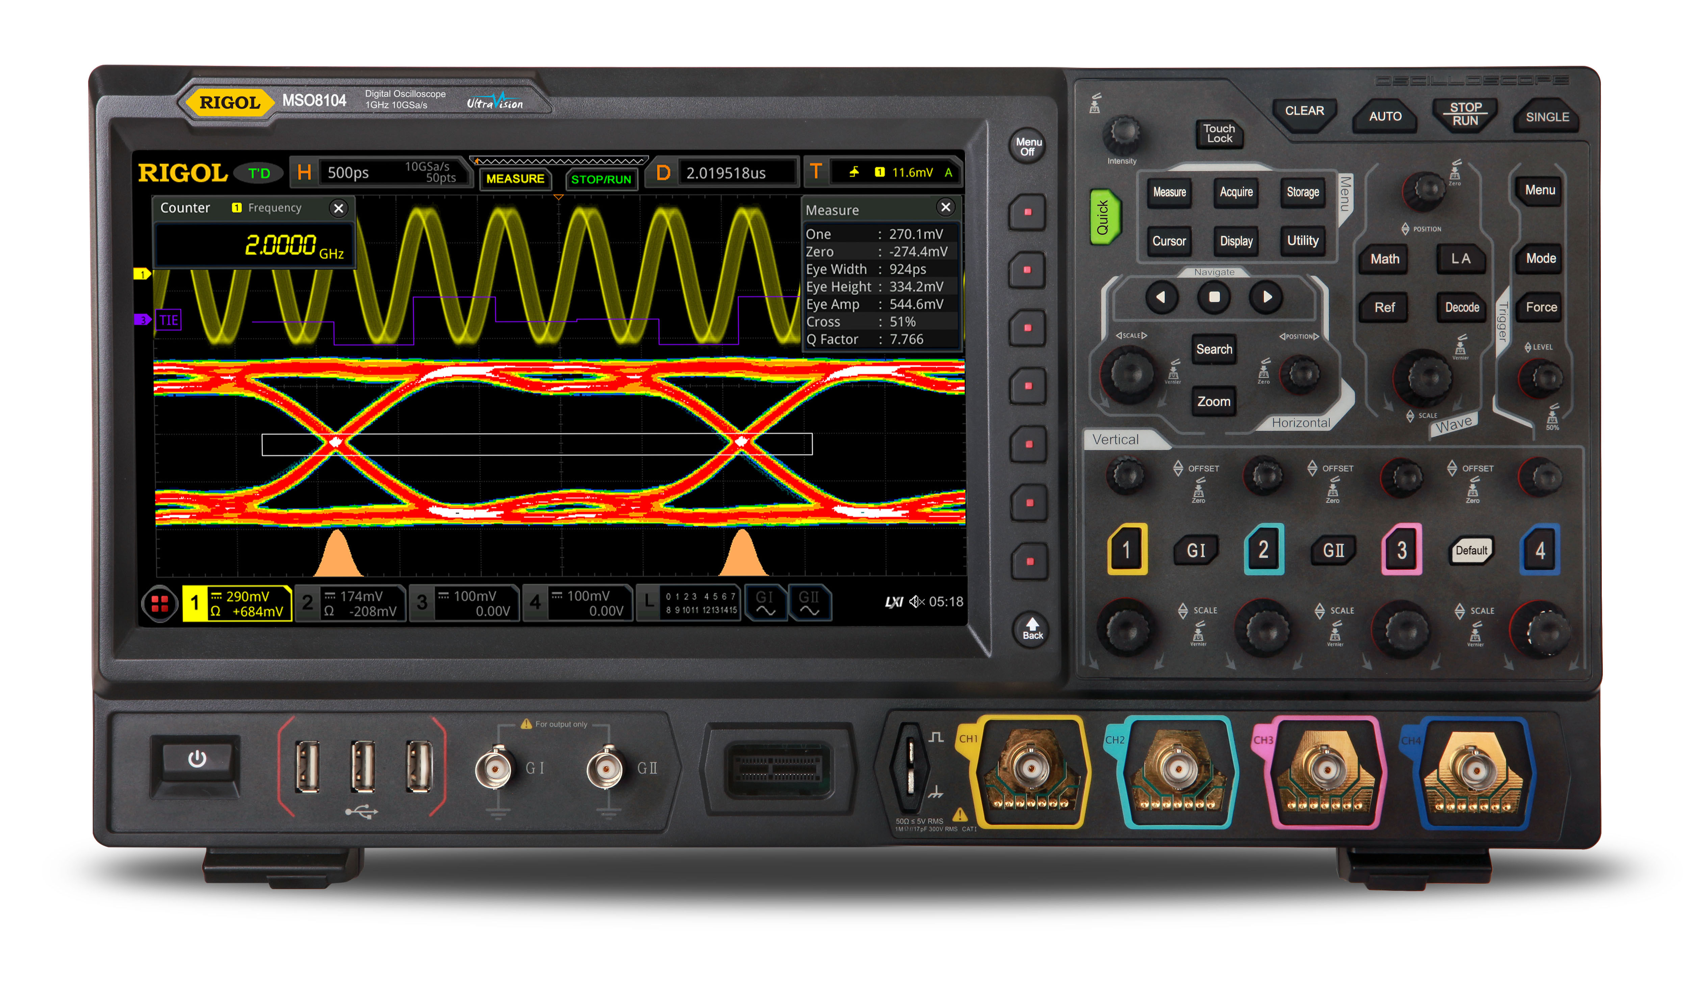
DBSP: Automatic Incremental View Maintenance for Rich Query Languages
Mihai Budiu, Leonid Ryzhyk - VMWare Research
Frank McSherry – Materialize.io
Val Tannen – University of Pennsylvania
September 2, 2022
UC Berkeley Sky/RISE Seminar Series

Slide 2
Motivation: VMware Skyline Proactive Intelligence
Identifying and resolving potential issues before they occur
VMware cloud service
https://www.vmware.com/support/services/skyline.html
Expert-written rules detect and report issues (e.g., misconfigurations)
VMware cloud
Customer cloud
Skyline
service
DB & UI
configs
upgrades
telemetry
issues
Browse problems

Slide 3
Query execution in Skyline
1350+ queries
Issues?
Data (JSON)
To DB/UI
Consumes JSON (10s MB/doc)
Very complex schema (100s entities, 1000s attributes)
Analyzes data in flight (no DB read/write)

Slide 4
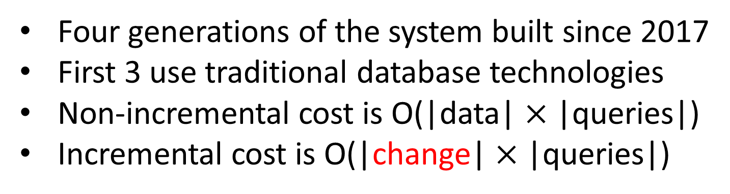
Scalability
Four generations of the system built since 2017
First 3 use traditional database technologies
Non-incremental cost is O(|data| $×$ |queries|)
Incremental cost is O(|change| $×$ |queries|)
Incremental engine

Slide 5
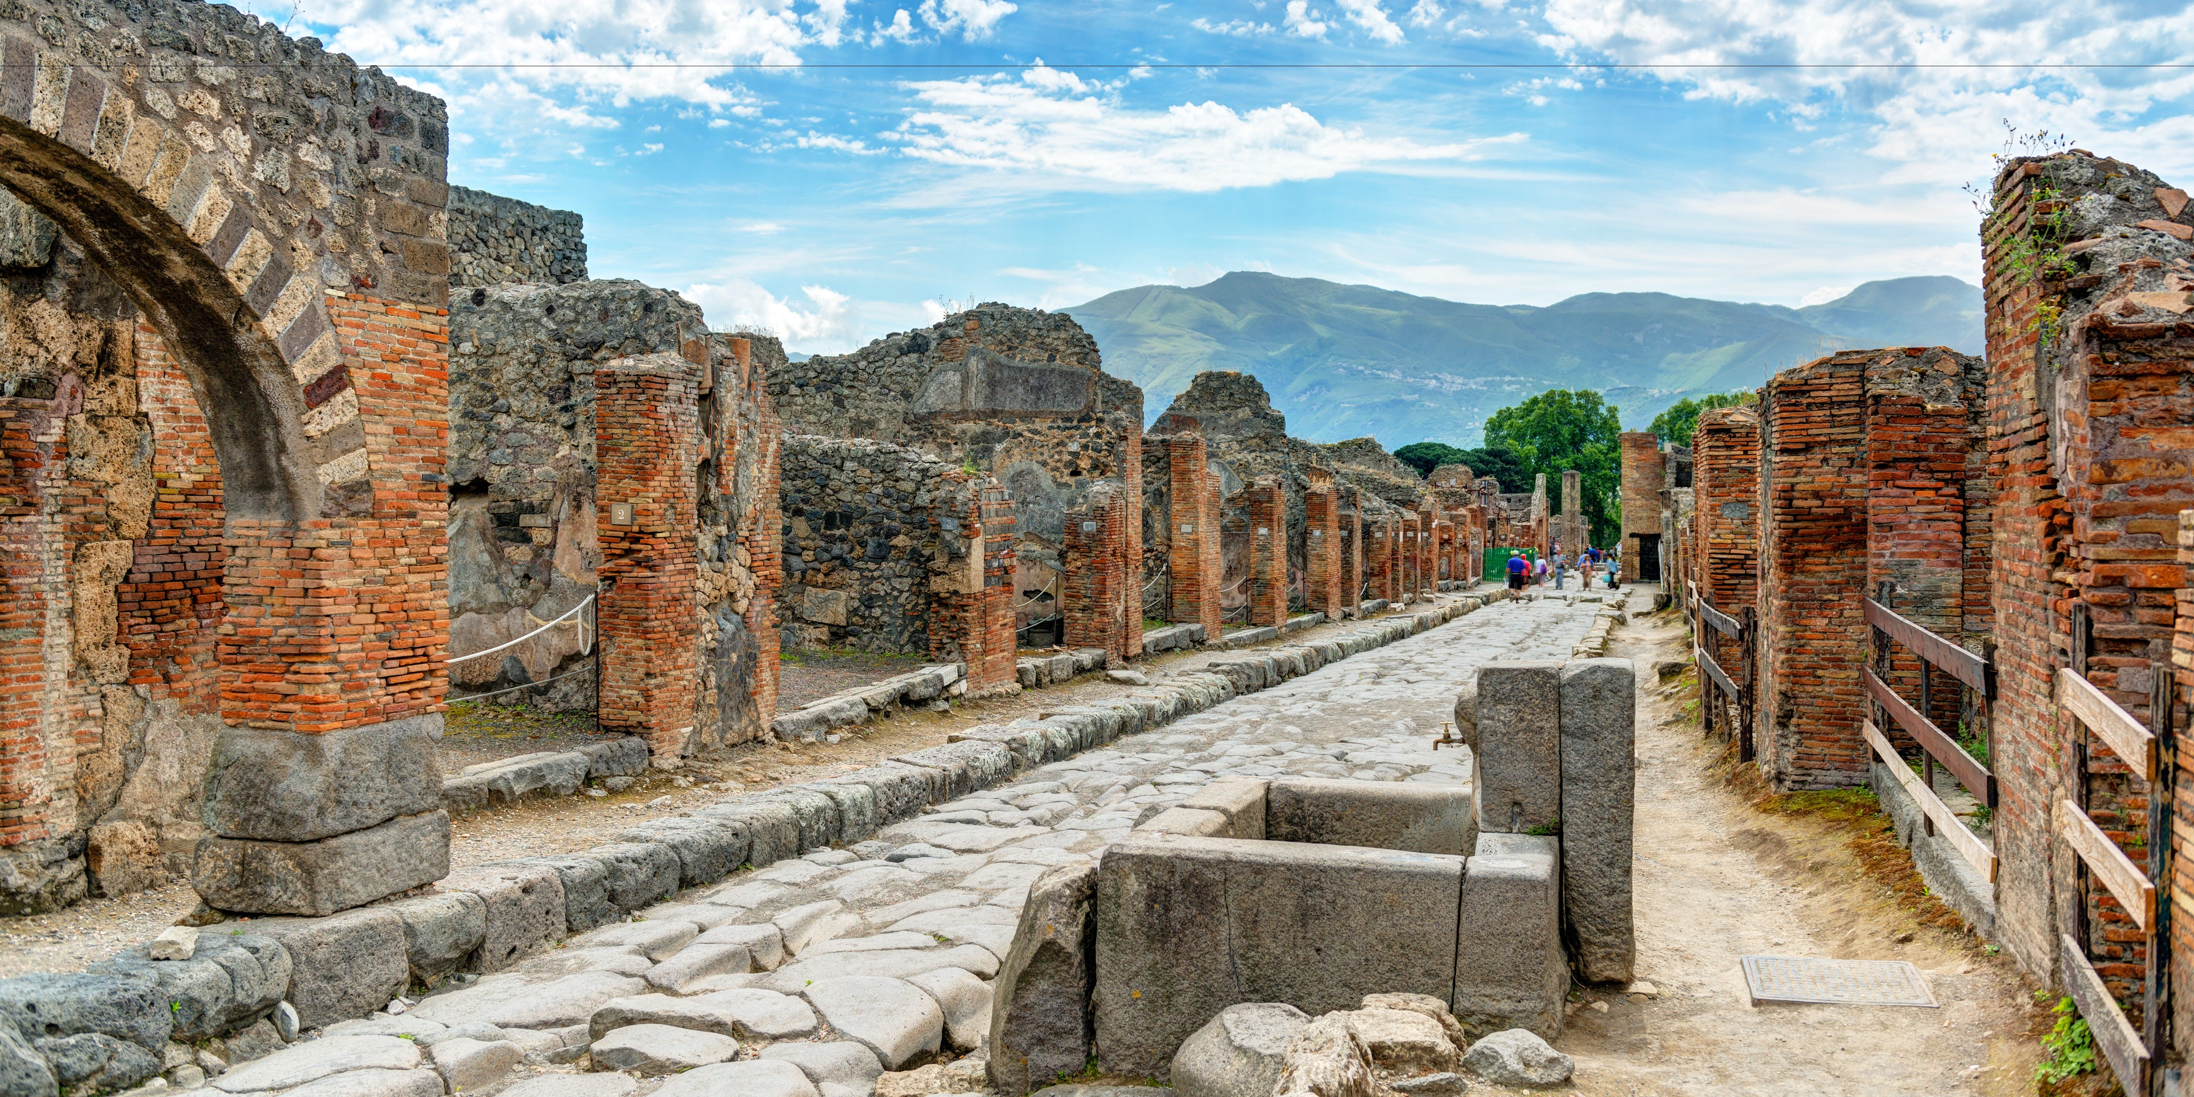
Brief History
Differential Dataflow (DD): framework for incremental computation [Murray, McSherry, et al, SOSP 2013] https://github.com/TimelyDataflow/differential-dataflow
Differential Datalog (DDlog): a programming language for incremental computation (VMware Research, 2019) https://github.com/vmware/differential-datalog/
built on DD
the query engine in Skyline
DBSP: formalize Differential Datalog (2021) https://github.com/vmware/database-stream-processor

Slide 6

Abstract
A simple language called DBSP
Four (4) operators
Based on Digital Signal Processing (DSP)
A formal definition of incremental computation in DBSP
An algorithm converting an arbitrary DBSP program to an incremental DBSP program
A recipe implementing DB queries in DBSP
https://arxiv.org/abs/2203.16684

Slide 7
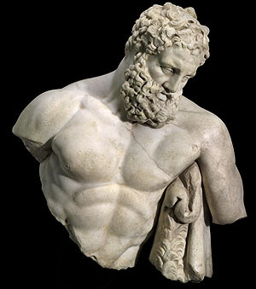
DBSP is powerful
It can model a rich class of database queries:
Relational (select, project, join, union, difference)
Computations on sets, bags, multisets
Nested relations (group-by, flatmap)
Aggregation
Recursion (monotonic and non-monotonic)
Stratified negation
Streaming computations (joins, window aggregates)
Relational while queries
More?
Corollary: we get automatically incremental evaluation for all these
The bold ones are new theoretical results in DD/DBSP
SQL
Datalog
CQL

Slide 8

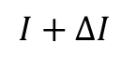
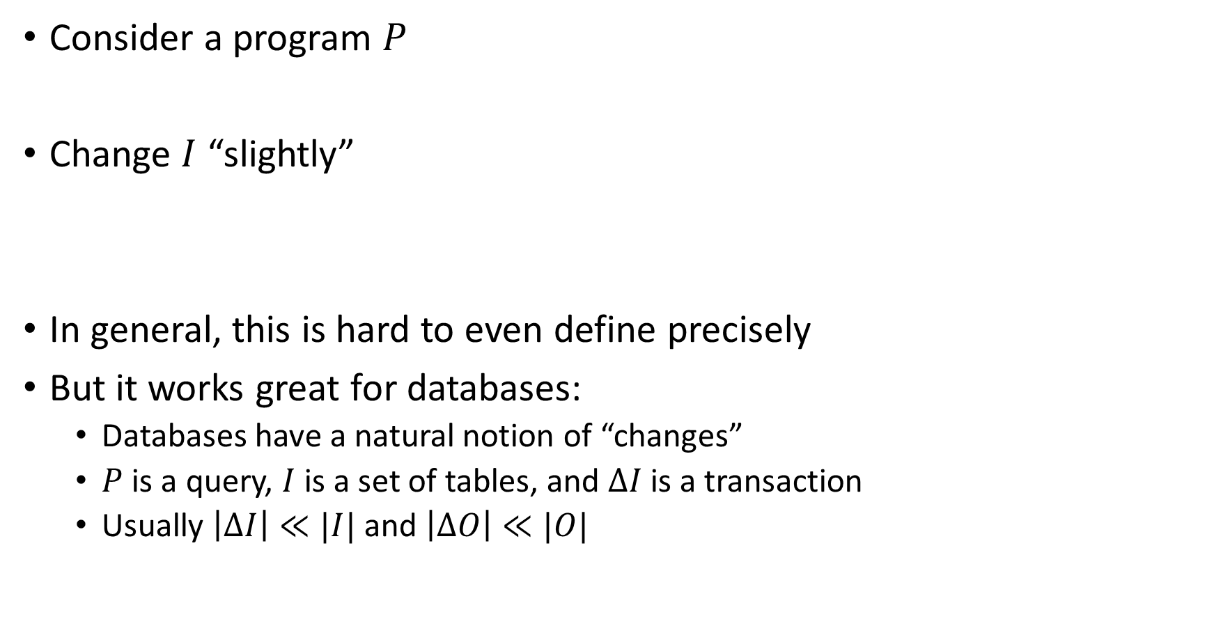
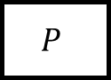
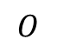
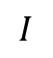
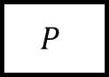
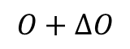
What is incremental computation?
Consider a program $P$
Change $I$ “slightly”
In general, this is hard to even define precisely
But it works great for databases:
Databases have a natural notion of “changes”
$P$ is a query, $I$ is a set of tables, and $ΔI$ is a transaction
Usually $\left|ΔI\right|≪|I|$ and $\left|ΔO\right|≪|O|$
$$I$$
$$P$$
$$O$$
reuse
$$I+ΔI$$
$$P$$
$$O+ΔO$$

Slide 9

Outline
Stream computations
Incremental computation
Optimizing incremental circuits
Implementing queries in DBSP

Slide 10
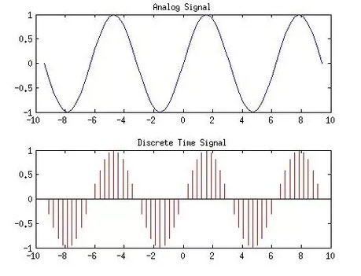
Analog and digital signals
Analog to digital conversion
Digital to analog conversion

Slide 11

Nyquist–Shannon sampling theorem
If a signal contains no frequencies higher than B hertz, it is completely determined by giving its values at a series of points spaced 1/(2B) seconds apart.
Our ears cannot hear more than 20khz
CDs sampling rate is 44.1khz
Analog signal
Analog circuit
Analog signal
A/D
D/A
Digital signal
Program
Digital signal

Slide 12
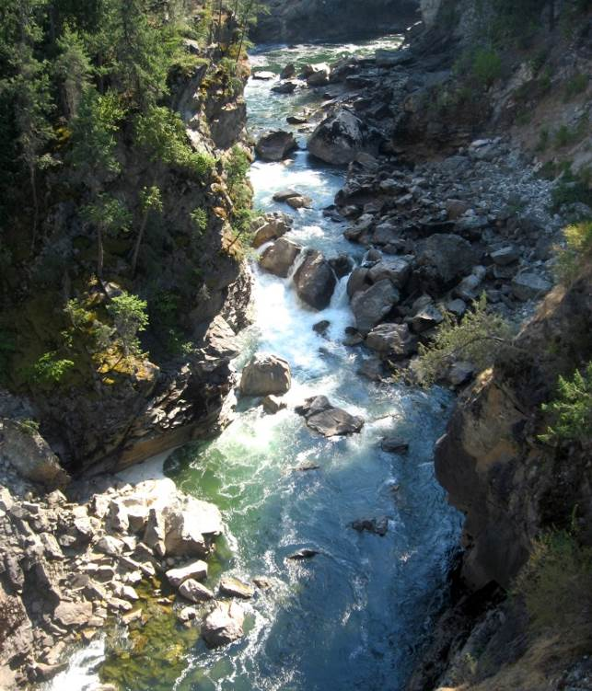
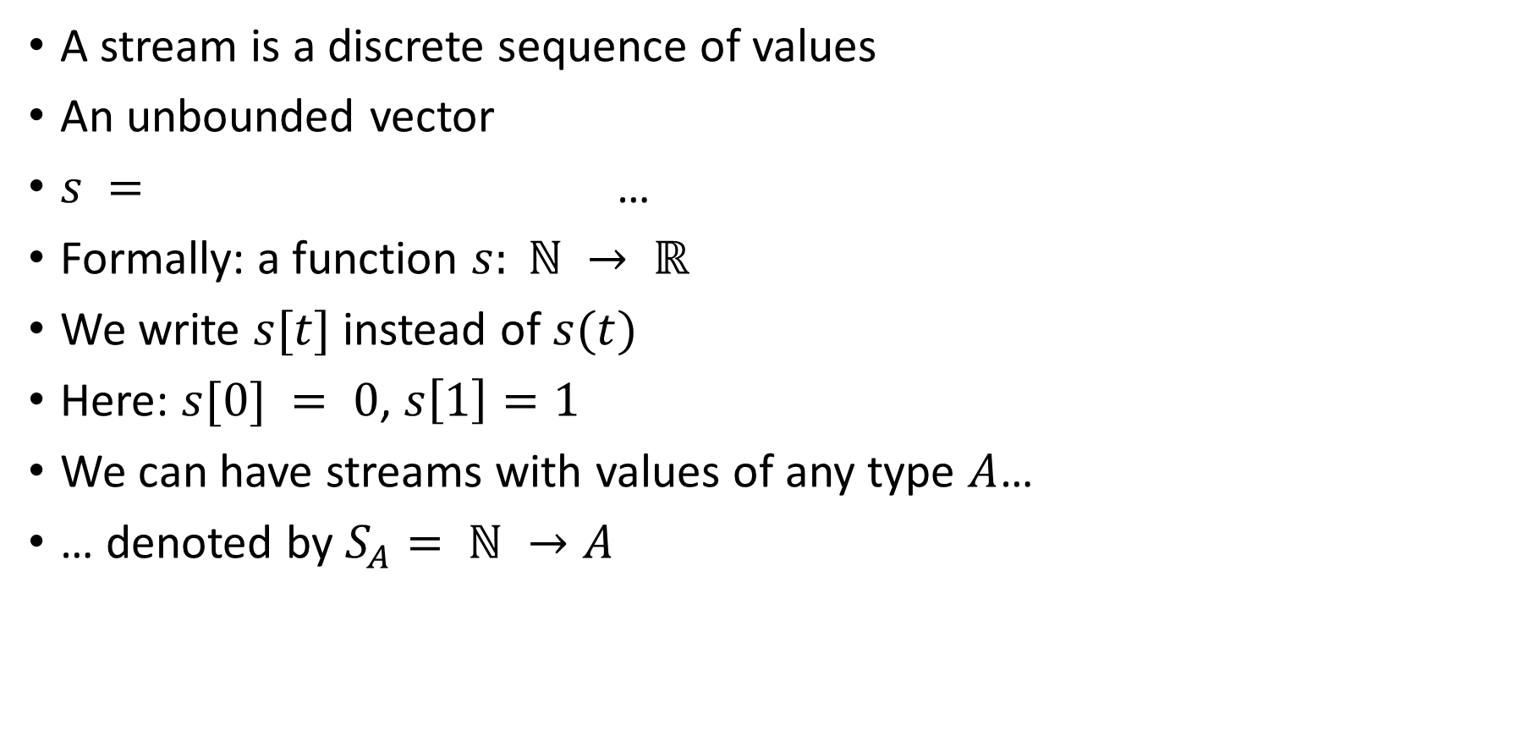
Streams
A stream is a discrete sequence of values
An unbounded vector
$s =$ …
Formally: a function $s: ℕ → ℝ$
We write $s[t]$instead of $s(t)$
Here: $s[0] = 0$, $s\left[1\right]=1$
We can have streams with values of any type $A$…
… denoted by $S_{A}= ℕ →A$
0
1
2
1
0
-1
-2
-1

Slide 13
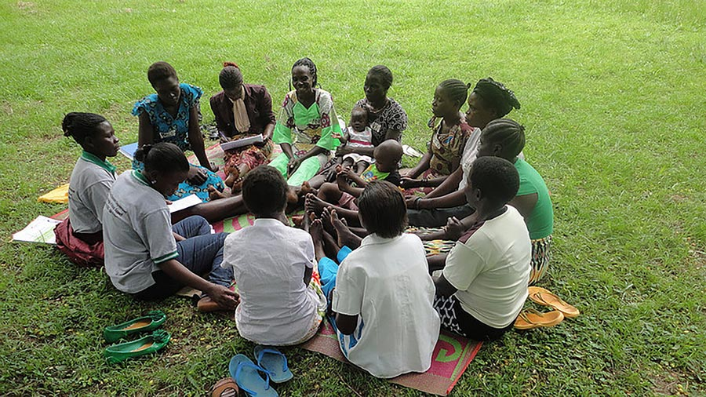
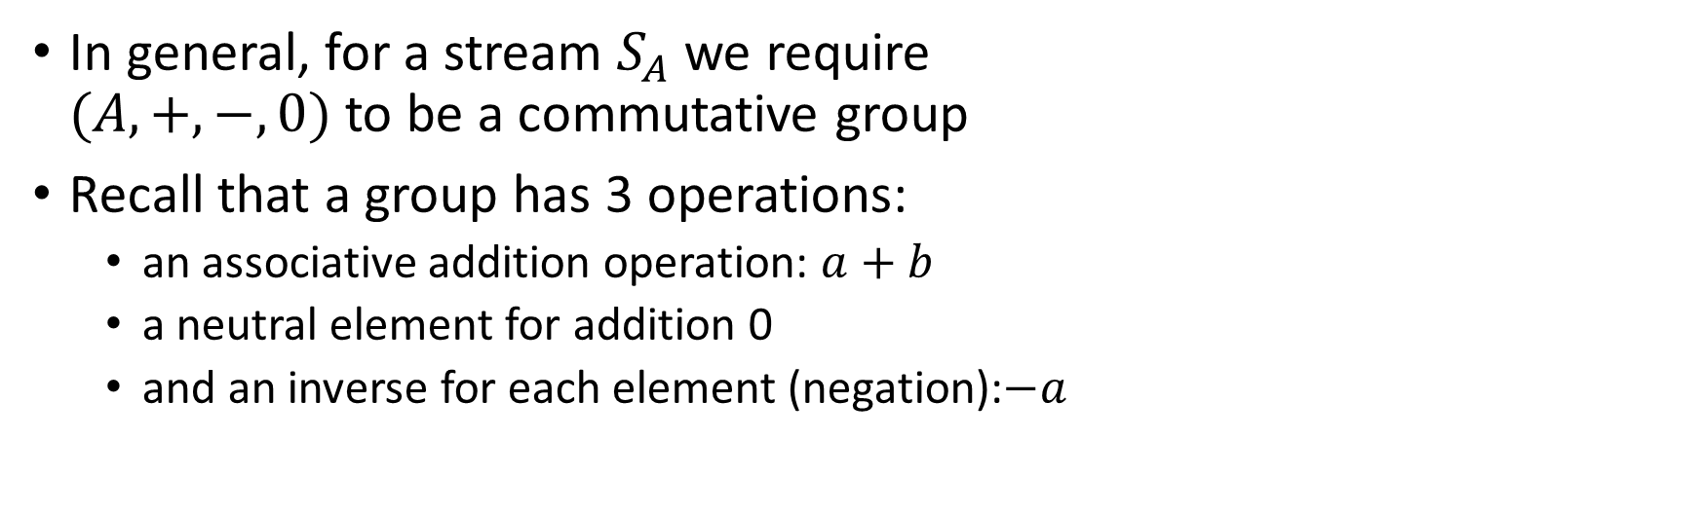
Groups
In general, for a stream $S_{A}$ we require $(A, +, −, 0)$ to be a commutative group
Recall that a group has 3 operations:
an associative addition operation: $a+b$
a neutral element for addition 0
and an inverse for each element (negation):$−a$

Slide 14
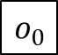
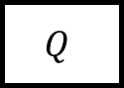
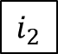
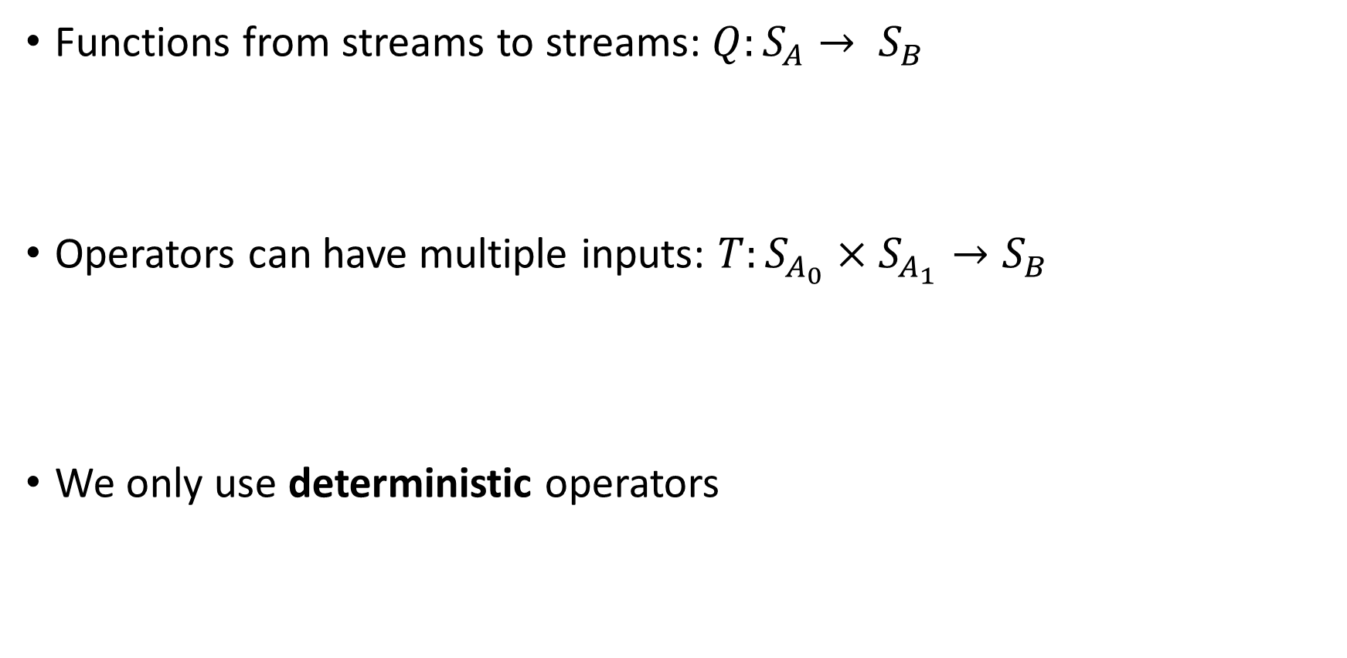
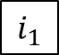
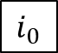
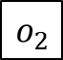
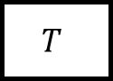
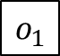
Stream operators
Functions from streams to streams:$Q:S_{A}→ S_{B}$
Operators can have multiple inputs: $T:S_{A_{0}}×S_{A_{1}}→S_{B}$
We only use deterministic operators
$$i_{0}$$
$$i_{1}$$
$$i_{2}$$
…
$$Q$$
$$o_{0}$$
$$o_{1}$$
$$o_{2}$$
…
…
$$T$$
…
…

Slide 15
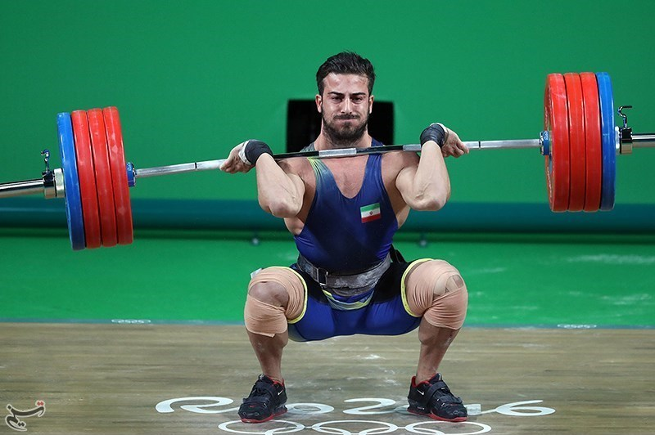
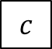
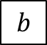
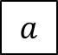
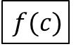
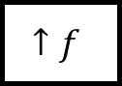
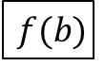
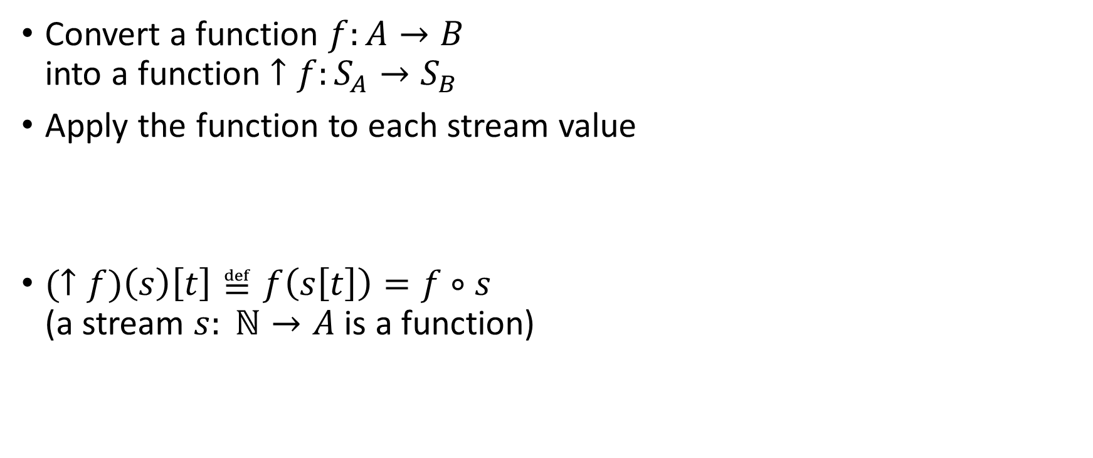
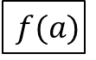
Lifting
Convert a function $f:A→B$ into a function $↑f:S_{A}→S_{B}$
Apply the function to each stream value
$(↑f)\left(s\right)\left[t\right]≝f\left(s\left[t\right]\right)=f∘s$ (a stream $s: ℕ→A$ is a function)
$$a$$
$$b$$
$$c$$
…
$$↑f$$
$$f(a)$$
$$f(b)$$
$$f(c)$$
…

Slide 16
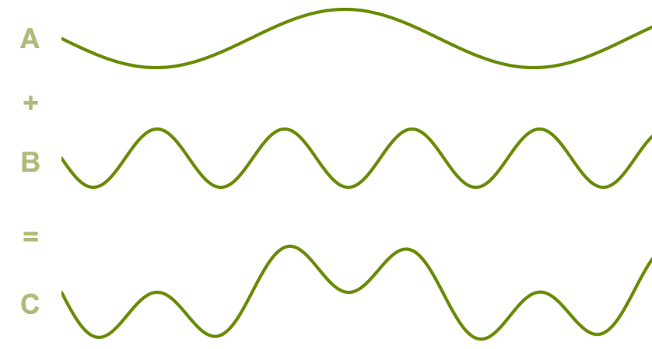
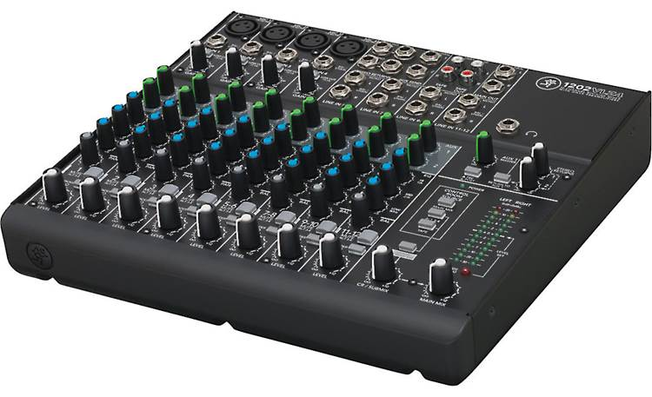
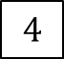
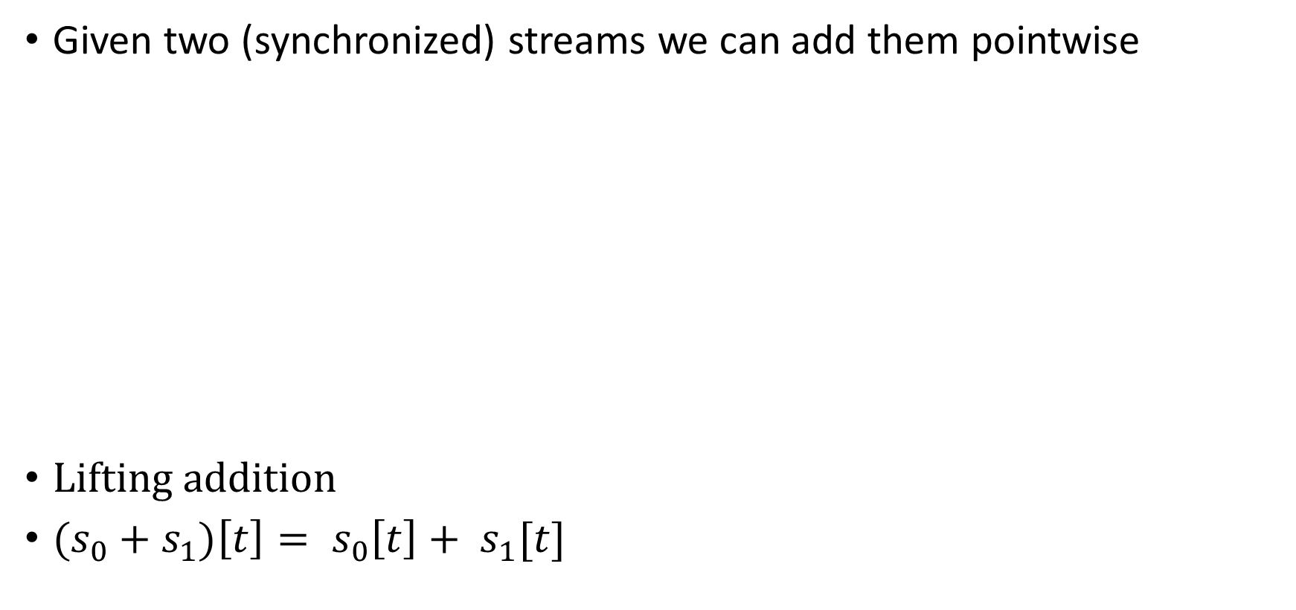
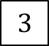

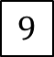

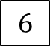

Addition
Given two (synchronized) streams we can add them pointwise
Lifting addition
${(s}_{0} + s_{1})\left[t\right]= s_{0}\left[t\right]+ s_{1}[t]$
$$1$$
$$2$$
$$3$$
…
+
5
7
$$9$$
…
$$4$$
$$5$$
$$6$$
…

Slide 17

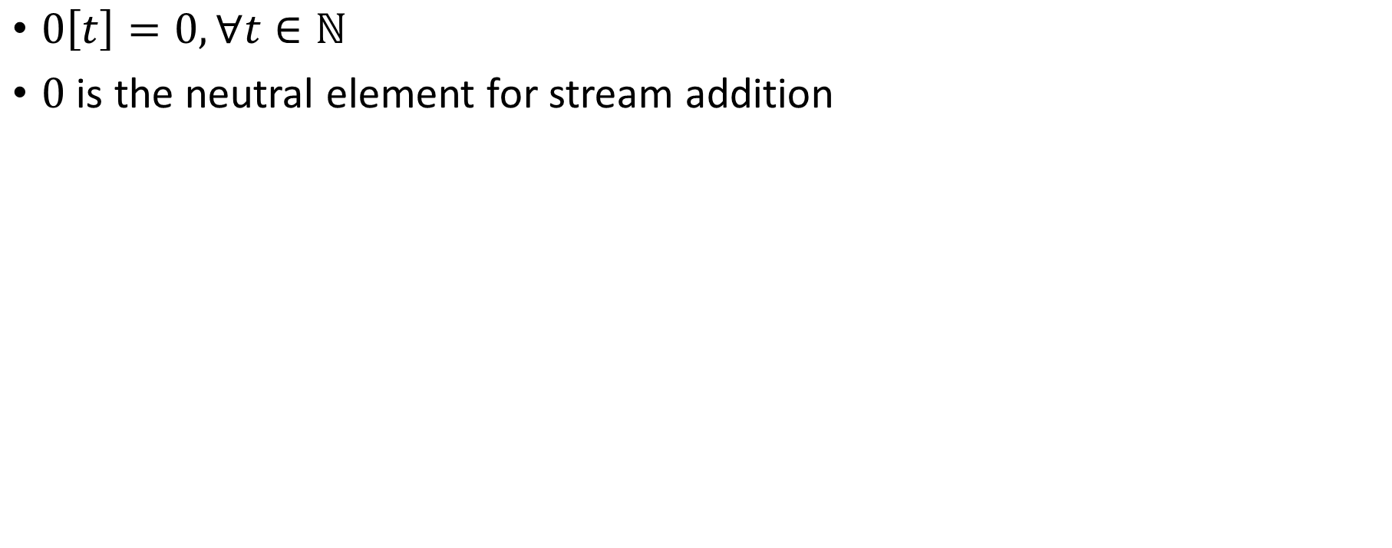
Silence
$0\left[t\right]=0, ∀t∈ℕ$
$0$ is the neutral element for stream addition

Slide 18
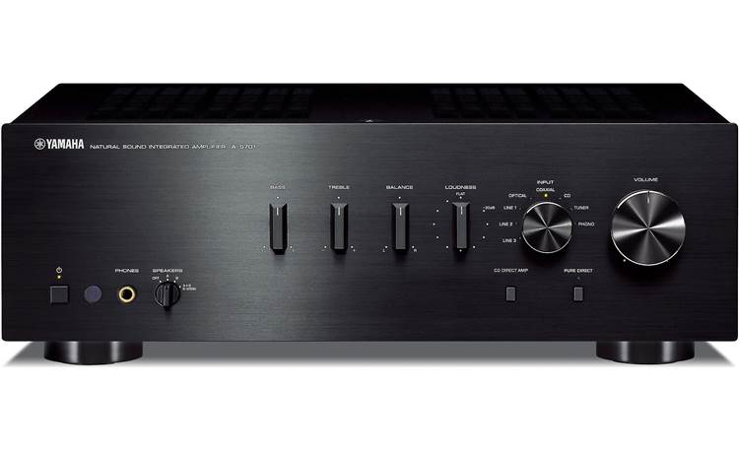
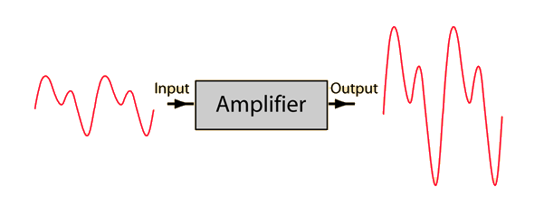
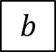
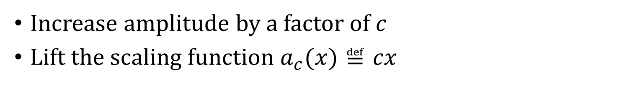
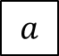
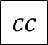
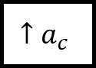
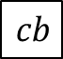


Amplification
Increase amplitude by a factor of $c$
Lift the scaling function $a_{c}(x)≝cx$
$$a$$
$$b$$
$$c$$
…
$$↑a_{c}$$
$$ca$$
$$cb$$
$$cc$$
…

Slide 19









Negation
Lifted unary minus
$−:S_{ℝ}→S_{ℝ}$
$\left(− s\right)\left[t\right]=−(s\left[t\right])$
$$a$$
$$b$$
$$c$$
…
$$−$$
$$−a$$
$$−b$$
$$−c$$
…

Slide 20







Chaining operators into circuits
Function composition
$$o=C(B(A\left(i1\right), D(i2))$$
$$i1$$
$$A$$
$$B$$
$$C$$
o
$$i2$$
$$D$$

Slide 21

Noise cancellation
Predict future values (easy for periodic signals)
Generate a negated stream
Add it to original stream
i
+
o
-

Slide 22







Circuit equivalence
Two circuits are equivalent iff they compute the same result given the same inputs
Function composition is associative => these circuits are equivalent:
$$A$$
$$B$$
$$C$$
$$⇔$$
$$A$$
$$B$$
$$C$$

Slide 23











Delay ($z^{−1}$ )
$z^{−1}:S_{A}→S_{A}$
Output is input delayed by one time unit
First value is 0
The name $z^{−1}$ comes from DSP (z-transform)
$$z^{−1}\left(i\right)\left[t\right]=\left\{\begin{aligned}0, t=0 \\ &i[t−1], t>0\end{aligned}\right.$$
$$a$$
$$b$$
$$c$$
$$d$$
…
$$z^{−1}$$
$$0$$
$$a$$
$$b$$
$$c$$
…

Slide 24


Time-invariance
A stream operator $T$ is time-invariant if does not “depend on time”
i.e., if you delay the input, you get a delayed output
i.e., these two circuits equivalent:
DBSP only uses time-invariant operators
Example which is not time-invariant: $Q\left(s\right)\left[t\right]= s\left[t\right]+ t mod 2$

Slide 25


Causal operators
Operator $Q$ is causal if $Q(i)[t]$ only depends on $i\left[0\right]… i\left[t\right]$ (past and present inputs) and not on $i[t+1]$, … (future inputs)
DBSP operators are causal
Example non-causal operator: play a song in reverse

Slide 26












Differentiation
What does this circuit compute?
$o\left[t\right]=s\left[t\right]–s\left[t−1\right]$
$o\left[0\right]=s\left[0\right]$
o is the derivative of the stream $s$ (as a function of time)
o
Denote this circuit by $D:S_{A}→S_{A}$
o is the stream of changes of s
$$1$$
$$2$$
$$3$$
$$2$$
…
$$D$$
$$1$$
$$1$$
$$1$$
$$−1$$
…
stream of changes

Slide 27











Integration
Denote this operator by $I: S_{A}→S_{A}$
If s is a stream of changes…
… then o is the original stream
What does this circuit compute?
This looks weird: o is recursively defined!
But it is well-defined
$o[0] =s[0]$
$o[t] =s[t] + o[t−1]$
Has a unique solution: $o\left[t\right]=\sum_{k=0}^{t}{s\left[t\right]}$
$o$ is the integral of $s$
o
$$1$$
$$1$$
$$1$$
$$−1$$
…
$$I$$
$$1$$
$$2$$
3
$$2$$
…
stream of changes

Slide 28

Some properties
$I$ and $D$ are
deterministic
causal
time-invariant
Theorem: $I∘D=D∘I=id$ (or $I=D^{−1}$)

Slide 29


Linear operators
A unary stream operator $Q:S_{A}→S_{B}$ is linear if:
$$Q\left(s+t\right)=Q\left(s\right)+Q\left(t\right)$$
$−$, $I$, $D$, $z^{−1}$, amplification are linear

Slide 30

Bilinear operators
A binary operator $×:S_{A}×S_{A}→S_{A}$ is bilinear if it distributes over addition
$$\left(s+t\right)×u=(s×u)+(t×u)$$
$$s×\left(u+v\right)=(s×u)+(s×v)$$
Example: lifted multiplication: $T\left(s,u\right)\left[t\right]=s\left[t\right]⋅u[t]$

Slide 31


Streams are groups
Theorem: If $A$is a commutative group, $SA$ is a commutative group
All streaming operations/properties described so far are well-defined/hold for an arbitrary commutative group $SA$
Time-invariance, determinism, causality, integration, differentiation, linearity, bilinearity, delay, etc.

Slide 32
Outline
Stream computations
Incremental computation
Optimizing incremental circuits
Implementing queries in DBSP

Slide 33










All databases are streaming databases!
Consider a database $DB$, a set of tables
A committed transaction is a change to $DB$
The set of linearized transactions define $T,$ a stream of changes to $DB$
$T[t]$is the $t$-th transaction
$DB$ is a stream of database snapshots
$DB[t]$ is the contents of the database after $t$ transactions have been executed
$DB[t] = I(T(t))$ – the integral of the transaction stream
$$T_{0}$$
$$T_{1}$$
$$T_{2}$$
$$T_{3}$$
…
$$I$$
$${DB}_{0}$$
$${DB}_{1}$$
$${DB}_{2}$$
$${DB}_{3}$$
…

Slide 34












Views
Let $Q$ be a query defining a view $V$ as a function of the database, e.g.:
CREATE VIEW V AS SELECT * FROM T WHERE Age >= 10
$V[t]=Q\left(DB[t]\right)$
$V$ is a stream of view snapshots:
$$V= ↑Q(DB)$$
$$↑Q$$
$$V_{0}$$
$$V_{1}$$
$$V_{2}$$
$$V_{3}$$
…
Versions of $V$
Versions of $DB$
$${DB}_{0}$$
$${DB}_{1}$$
$${DB}_{2}$$
$${DB}_{3}$$
…

Slide 35













Incremental view maintenance
The incremental maintenance of $V$ is performed by
${(↑Q)}^{Δ}≝ D∘(↑Q)∘I$
$${(↑Q)}^{Δ}$$
$$T_{0}$$
$$T_{1}$$
$$T_{2}$$
$$T_{3}$$
…
$$I$$
$$↑Q$$
D
$$ΔV_{0}$$
$$ΔV_{1}$$
$$ΔV_{2}$$
$$ΔV_{3}$$
…
Changes to $DB$
Changes to $V$
$$V_{0}$$
$$V_{1}$$
$$V_{2}$$
$$V_{3}$$
…
Versions of $V$
Versions of $DB$
$${DB}_{0}$$
$${DB}_{1}$$
$${DB}_{2}$$
$${DB}_{3}$$
…

Slide 36



Multiple inputs
This generalizes to operators with multiple inputs or outputs
E.g., for a binary stream operator $T:S_{A_{0}}×S_{A_{1}}→S_{B}$
$$T^{Δ}$$

Slide 37


Fundamental Equation of Incremental View Maintenance
$$Q^{Δ}=D∘Q∘I$$
Defined even for streaming queries $Q$ (not lifted)
As written, $Q^{Δ}$ is expensive to compute
However, we can often optimize the computation significantly
Notice: we don’t need to compute $\frac{dQ(s)}{ds}$

Slide 38










Incremental queries are streaming systems
$${Δi}_{0}$$
$${Δi}_{1}$$
$${Δi}_{2}$$
$${Δi}_{3}$$
…
$$Q^{Δ}$$
$$Δo_{0}$$
$$Δo_{1}$$
$$Δo_{2}$$
$$Δo_{3}$$
…
state
$Q^{Δ}$ is a streaming system:
it runs forever
it maintains internal state (even if $Q$ is stateless)

Slide 39
Outline
Stream computations
Incremental computation
Optimizing incremental circuits
Implementing queries in DBSP

Slide 40
























Linear operators
Theorem: For a linear stream operator $Q$ we have $Q=Q^{Δ}$
(most operators used in DB queries are linear)
Why is this better?
Assume $\left|T\left[t\right]\right|≪|DB[t]|$
Optimized:
A speedup of $O(\left|DB\right|/|T|)$
$$T_{0}$$
$$T_{1}$$
$$T_{2}$$
$$T_{3}$$
…
$$I$$
$$Q$$
D
$$ΔV_{0}$$
$$ΔV_{1}$$
$$ΔV_{2}$$
$$ΔV_{3}$$
…
$${DB}_{0}$$
$${DB}_{1}$$
$${DB}_{2}$$
$${DB}_{3}$$
…
$$T_{0}$$
$$T_{1}$$
$$T_{2}$$
$$T_{3}$$
…
$$Q$$
$$ΔV_{0}$$
$$ΔV_{1}$$
$$ΔV_{2}$$
$$ΔV_{3}$$
…

Slide 41
Example of a linear query
CREATE VIEW V AS SELECT * FROM T WHERE Age >= 10
“Shardable” queries
You don’t need to know what’s in T to compute the changes to V
Most relational queries use linear operators!

Slide 42






The chain rule (structural recursion)
$$(Q_{2}{∘Q_{1})}^{Δ}=Q_{2}^{Δ}∘Q_{1}^{Δ}$$
Proof by pictures:
We can incrementalize a complex circuit by incrementalizing each component independently
For a chain of linear operators: $(Q_{2}{∘Q_{1})}^{Δ}=Q_{2}^{Δ}∘Q_{1}^{Δ}=Q_{2}∘Q_{1}$
$$⇔$$
$$⇔$$
$$⇔$$

Slide 43



Bilinear operators
(Lifted) join, intersection, Cartesian product
From distributivity:$Δ\left(A×B\right)=\left(A×ΔB\right)+\left(ΔA×B\right)+\left(ΔA×ΔB\right)$
Speed-up is $O(\frac{\left|A\right|}{\left|ΔA\right|}+\frac{\left|B\right|}{\left|ΔB\right|})$
$$⇔$$

Slide 44



The cycle rule
$$⇔$$
Allows us to recursively incrementalize circuits with feedback
All our circuits are built from:
Sequential composition
Feedback loops
We get a structural recursion scheme for incrementalizing any circuit

Slide 45
Outline
Stream computations
Incremental computation
Optimizing incremental circuits
Implementing Queries in DBSP

Slide 46

Computing on tables
SQL queries are functions from tables to tables: $$Q:T_{0}×…×T_{n}→T$$
T
Query
Query result
Name | Age
Mike | 10
John | 12
Amy | 8
Chris | 10
Name | Age
Mike | 10
John | 12
Chris | 10
SELECT * FROM T WHERE Age >= 10

Slide 47

Hold on! This is not well-defined!
The definitions of $I$, $D$ require streams over a commutative group
However, tables (sets, multisets) are not groups
E.g., there is no table negation
Solution:
Generalize tables to obtain a commutative group

Slide 48


$ℤ$-sets (also called $ℤ$-relations)
Generalize sets so that each element has an integer weight
The weight can be positive, zero, or negative
$ℤ$-set = key-value map:
Key = tuple
Value = weight
Formally: a $ℤ$-set is a function $r: T→ℤ$
$T$ is the type of the tuples
With finite support (finite number of rows)
Name | Age | Weight
Mike | 10 | 1
John | 12 | 3
Amy | 8 | -1
Chris | 10 | 2
tuples

Slide 49



$ℤ$-sets are yummy!
Can represent both tables and changes to tables
Positive weights = elements added
Negative weights = elements removed
Generalize sets and multisets
Classic DB table = $ℤ$-set where all weights are 1
Form a commutative group (because $ℤ$ is a group)

Slide 50

$ℤ$-set addition
Name | Weight
Mike | 1
John | 3
Amy | -1
Chris | 2
Name | Weight
Mike | -1
Dan | 1
Chris | 1
Name | Weight
Dan | 1
John | 3
Amy | -1
Chris | 3
+
=

Slide 51


The distinct operator
“Converts” a $ℤ$-set into a set
$distinct\left(r\right)\left[t\right]= \left\{\begin{aligned}1 if r\left[t\right]>0 \\ 0 otherwise\end{aligned}\right.$
Name | Weight
Dan | 1
John | 3
Amy | -1
Chris | 3
Name | Weight
Dan | 1
John | 1
Chris | 1
$$distinct\left( \right)=$$

Slide 52
Multiset union (can have duplicates)
SELECT * FROM T1 UNION ALL SELECT * FROM T2
T1
+
V
T2

Slide 53

Set union (no duplicates)
SELECT * FROM T1 UNION SELECT * FROM T2
T1
+
$$distinct$$
V
T2

Slide 54

Set difference
SELECT * FROM T1 EXCEPT SELECT * FROM T2
T1
+
$$distinct$$
V
T2
-
Recall: distinct removes elements with negative weights

Slide 55


Query composition
SELECT … FROM (SELECT … FROM T)
T
$$Q_{1}$$
$$Q_{2}$$
V
Query composition is circuit chaining (function composition).

Slide 56



Relational algebra using $ℤ$-set operations
Recursively defined on query structure
Many operations require a $distinct$
(But many can be removed)
The other operations are all linear or bilinear

Slide 57

Algorithm for incremental view maintenance
Translate recursively a DB query into a circuit $Q$ on $ℤ$-sets
1.5 Eliminate some distinct calls
Lift circuit to compute on streams: $↑Q$
Build incremental version of lifted circuit:
$${(↑Q)}^{Δ}≝D∘↑Q∘I$$
Optimize $Q^{Δ}$ using structural recursion:
$$(Q{∘R)}^{Δ}=Q^{Δ}∘R^{Δ}$$
This algorithm is deterministic. There are no heuristics.

Slide 58

DBSP can also express
Nested collections
Group-by (linear!)
Flatmap (linear!)
Aggregation
Recursive queries (fixed points)
Streaming joins, streaming windows
Relational while queries (“Turing complete queries”)
We don’t have a characterization of the power of DBSP

Slide 59



Definition of Differential Datalog
DDlog compiler
receives as input a query $Q$, written in Datalog
Produces as output an implementation of ${(↑Q)}^{Δ}$, written in Rust
stream of input changes
DDLog
program
DDlog compiler
Rust
Program
$${(↑Q)}^{Δ}$$
Rust compiler
Native library
$$Q$$
stream of output changes
Differential dataflow
library

Slide 60

DBSP Library
https://github.com/vmware/database-stream-processor
Rust framework to describe DBSP circuits
Support for relational algebra, nested relations, aggregates, etc.
Multi-core execution
Benchmarks are leaving Flink in the dust
No optimizer (yet)

Slide 61
SQL to DBSP compiler
https://github.com/vmware/sql-to-dbsp-compiler
Generates Rust programs using DBSP as a runtime
Based on Apache Calcite SQL compiler (Java)
Quickly evolving

Slide 62

We have barely begun
Distributed execution
Formal verification
Persistence
Fault-tolerance
Load-balancing
Runtime queries
Cloud service
Integration in existing systems (SQL, Spark, Rust, etc.)
Applications

Slide 63
Extra slides

Slide 64
Set intersection
SELECT * FROM T1 INTERSECT SELECT * FROM T2
O(x) :- T1(x), T2(x).
This is a disguised JOIN. We will see it soon.

Slide 65






Projection
SELECT Age FROM T
In DDlog:
O(age) :- T(_, age).
The weight of $t$ = sum of weights of all tuples that project to $t$
$$π_{C}\left(m\right)\left[t\right]=\sum_{\begin{aligned}x∈m \\ π_{C\left(x\right)}=t\end{aligned}}{m[x]}$$
$$T$$
$${↑π}_{C}$$
$$distinct$$
$$V$$
Name | Age | Weight
Mike | 10 | 1
John | 12 | 3
Amy | 8 | -1
Chris | 10 | 2
Age | Weight
10 | 1+2
12 | 3
8 | -1
SELECT Age

Slide 66
Translating a DDlog rule
Rule head
Rule body
RelationHead :- RelationTerm0, not RelationTerm1.
Head relation = circuit output
Relations in body = circuit inputs
Rule body = circuit contents
Edges in circuit = conjunctions in rule body
Turnstyle = projection
Compiled to
RelationTerm0
proj
RelationHead
RelationTerm1

Slide 67
Selection (filtering)
SELECT * FROM T WHERE predicate
O(t) :- T(t), predicate(t).
Name | Age | Weight
Mike | 10 | 1
John | 12 | 3
Amy | 8 | -1
Chris | 10 | -2
Name | Age | Weight
Mike | 10 | 1
John | 12 | 3
Chris | 10 | -2
WHERE Age >= 10

Slide 68



Selection (filtering)
SELECT * FROM T WHERE predicate
V(t) :- T(t), predicate(t).
$$σ:ℤ\left[T\right]→ℤ[T]$$
$$σ\left(m\right)[t]=\left\{\begin{aligned}m\left[t\right], if predicate(t) \\ 0, otherwise\end{aligned}\right.$$
$$T$$
$$↑σ$$
V
$σ$ keeps all tuples for which the predicate is true.

Slide 69
Cartesian products
V(t1, t2) :- T1(t1), T2(t2).
SELECT T1.*, T2.* FROM T1, T2
Name | Age | Weight
Mike | 10 | 1
John | 10 | 3
Amy | 10 | -1
Chris | 10 | 2
Mike | 12 | 3
John | 12 | 9
Amy | 12 | -3
Chris | 12 | 6
Name | Weight
Mike | 1
John | 3
Amy | -1
Chris | 2
Age | Weight
10 | 1
12 | 3
x
=
Multiply weights.

Slide 70


Cartesian products
V(t1, t2) :- T1(t1), T2(t2).
SELECT T1.*, T1.* FROM T1, T2
$m_{1}∈ℤ\left[T_{1}\right],$ $m_{2}∈ℤ\left[T_{2}\right]$, ($m_{1}×m_{2})\left[\left(t_{1}, t_{2}\right)\right]≝m_{1}\left[t_{1}\right]⋅m_{2}\left[t_{2}\right]$
T1
$$↑×$$
V
T2

Slide 71


(Equi)Joins
SELECT Name, Age FROM T1 JOIN T2 ON T1.Name=T2.Name
O(Name, Age) :- T1(Name, Age), T2(Name, _).
T1
$$↑×$$
$$↑σ$$
V
T2
Cartesian product followed by filtering.

Slide 72




Optimizing distinct
Distinct is idempotent: $distinct∘distinct=distinct$
For many relational queries $Q$ the following holds ($Q$ one of select, project, join, map, flatmap, union, intersection)
For Q in join, product, filter, select we have
$$⇔$$
$$⇔$$

Slide 73



Incremental distinct
$$⇔$$
Work proportional to $|d|!$

Slide 74

Complex Relational Example
CREATE VIEW V AS SELECT DISTINCT a.x, b.y FROM ( SELECT t1.x , t1.id FROM t1 WHERE t1.a > 2 ) a JOIN ( SELECT t2.id , t2.y FROM t2 WHERE t2.s > 5 ) b ON a.id = b.id
Inputs and outputs are collections, not streams

Slide 75



Example: Remove distinct calls
⬄
⬄
⬄

Slide 76


Example: Lift and incrementalize
Inputs and outputs are streams
Inputs and outputs are streams of changes

Slide 77


Example: optimize incremental circuit
Chain rule and linearity
Expand join and distinct

Slide 78

Related work
Incremental View Maintenance
Streaming Databases
Streaming languages
Functional Languages
Category theory
Dataflow machines
Synchronous circuits

Slide 79


Materialized View Update Problem
We essentially cover this whole space
IEEE Data Engineering Bulletin, 1995

Slide 80



The ring of weights ($ℤ)$
The multiplication of $ℤ$ shows up in the join implementation …
… where weights of matching keys are multiplied
That’s why joins are bilinear (because $×$ distributes over $+$)

Slide 81

Additional SQL operations
Map (select)
Group-by (nested relations)
Flatmap
Aggregation
Order-by: not a particularly efficient model in DBSP

Slide 82


map_keys(f)
Generalization of SQL SELECT
Given $f:A→B$ the operator map_keys$\left(f\right):ℤ\left[A\right]→ ℤ[B]$ is: map_keys$\left(f\right)\left(i\right)=\sum_{x∈i}{i\left[x\right]⋅f(x)}$
Apply $f$ to each key and “weigh” the result
map_keys$(f)$is linear for any function $f$
Weight of $x$

Slide 83


Groupings
A grouping maps a key to a $ℤ$-set: $K→ℤ\left[A\right]$
Given a key, return a $ℤ$-set
This structure is $ℤ\left[A\right]\left[K\right]$
This is a mathematical group!
Weight
Key | Z-set
K1
K2
K3

Slide 84

Group-by
Given a type of keys $K$ and a function $k: A→K$, groupby$\left(k\right): ℤ\left[A\right]→ℤ\left[A\right]\left[K\right]$ builds a grouping from a $ℤ$-set
groupby is a linear function!
Each tuple in the input delta will affect only one grouping
So ($↑$groupby)$Δ =$ ($↑$groupby)

Slide 85


flatmap_keys
Given $f:A→ℤ[B]$, define flatmap_keys$\left(f\right):ℤ\left[A\right]→ ℤ[B]$ as: flatmap_keys$\left(f\right)\left(i\right)≝\sum_{x∈i}{i\left[x\right]⋅f(x)}$
flatmap_keys is linear for any $f$!
Substitute$ℤ[B][K]$ for $A$, and id: $ℤ\left[B\right]→ ℤ[B]$ for$f$
flatmap_keys(id):$ℤ\left[B\right]\left[K\right]→ℤ[B]$is the right-inverse of group-by
Weight of $x$

Slide 86

Aggregation
Aggregation functions such as weighted SUM and COUNT are linear functions $ℤ\left[ℝ\right]→ℝ$!
$a_{SUM}(s)=\sum_{x∈s}{x×s\left[x\right]}$
(But not linear as functions $ℤ\left[ℝ\right]→ℤ[ℝ]$!)
SELECT SUM(c) FROM I
makeset converts a $ℝ$scalar into a singleton $ℤ$-set
makeset(5) = $\{ 5↦1 \}$
makeset is not linear, but it is not expensive to incrementalize

Slide 87

Non-linear aggregations
E.g., min, max
… or their generalization, top-K
These are not linear on a group structure (they are linear on a monoid… but can’t handle negation)
Implemented using the “brute force” formula:
$${(↑Q)}^{Δ}= D∘(↑Q)∘I$$
The integral is there to “remember” the full set
Can be built efficiently (log work in $|I|$) using a priority queue

Slide 88
Group-By + Aggregate
The composition of
Group-by
map_weights(aggregate)
map_weights applies a function to each grouping
Not to be confused with map_keys from before
Linear if the aggregate function is linear

Slide 89


Parallelization
Join on two threads
Volcano “exchange” operator (from 2 threads to 3 threads)

Slide 90
Outline
Recap: streaming and incremental computations
SQL in DBSP
Streaming queries in DBSP
Datalog in DBSP

Slide 91

Convolutions
Window-based computation
Window is defined by the input transactions (not by the contents of the data stream)

Slide 92


Streaming joins
$t$ are changes to a table
$s$ is a stream
Table $I(t)$ is joined with every stream value in $s$
$o$ is also a stream

Slide 93


Streaming window queries
$θ$ is a stream of wall-clock values (time)
$s$ is a stream of timestamped data
$W$ window function, filters data in $s$ based on timestamp and time

Slide 94


Alternative window definition
In each transaction
$A$ = what is added
$S$ = what is subtracted from window

Slide 95
Outline
Recap: streaming and incremental computations
SQL in DBSP
Streaming queries in DBSP
Datalog in DBSP

Slide 96
Datalog rules
Rule head
Rule body
sibling(x, y) :- parent(z, x), parent(z, y).
Head relation = circuit output
Relations in body = circuit inputs
Rule body = circuit contents
Conjunctions in rule body = edges in circuit
Turnstyle = projection
Compiled to
proj
sibling
parent

Slide 97


Negation
Stratified: non-recursive
Implemented as either
Subtraction
Anti-join

Slide 98

Recursive computations
Reach(x, y) :- Edge(x, z), Reach(z, y).
The semantics iterates until convergence
To implement “loops” we introduce two new operators:
$δ_{0}$ (enter)
$∫$(exit)

Slide 99


Creating streams from scalars
$$δ_{0}:A→S_{A}$$
$$δ_{0}\left(a\right)\left[t\right]≝\left\{\begin{aligned}a, t=0 \\ &0, t>0\end{aligned}\right.$$
Linear!
scalar
stream
9
9, 0, 0, 0, 0, 0, …

Slide 100


Creating scalars from streams
Only defined for streams that are zero almost everywhere:
$$∫{ :S}_{A}→A$$
$$∫\left(s\right) ≝ \sum_{t≥0}{s\left[t\right]}$$
Linear!
stream
scalar
1, 2, 3, 0, 0, 0, …
6

Slide 101



Implementing recursion (1)
Start with a recursive query O = R(I, O) where I and O are relations, and R is a query (on $ℤ$-sets)
Implement R as a (non-recursive) circuit $R:$
Lift to compute on streams:

Slide 102

Implementing recursion (2)
(3) Connect recursive output to input using a delay
(4) Bracket as follows:

Slide 103
Typing
Scalars (not streams!)
Streams

Slide 104
Inputs
a,0,0,0,…
a,a,a,a,…
a

Slide 105


Theorem: this circuit computes fixed-point of $R$
Denote by $S\left(x\right)=λx.R(a, x)$, where $a$ is the value of input I
$o\left[0\right]=R\left(a, 0\right)=S(0)$
$o\left[1\right]=R\left(a, o\left[0\right]\right)= S\left(o\left[0\right]\right)=S\left(S\left(0\right)\right)$
$o\left[k\right]=S^{k+1}\left(0\right)$
If $o[k] = o[k+1]$, then $∀i≥0 o\left[k+i\right]=o[k]$
Starting from $k$ all outputs of $D$ are 0
(But computation may never converge)

Slide 106
Two kinds of streams
Streams were used previously to model time-evolution of a system
Now we use streams to model the execution of a loop
The stream values are consecutive values of the variables in the loop body

Slide 107

Example: Transitive closure
reach(x, y) :- edge(x, y).
reach(x, y) :- edge(x, z), reach(z, y).
edge
reach
edge
join(edge, reach)

Slide 108


Semi-naïve evaluation
$$⇔$$
Cycle rule => correctness of semi-naïve Datalog evaluation

Slide 109

Streaming, incremental, recursive queries
So far we have implemented a recursive non-streaming query
To make it incremental we apply the same recipe as before…
… treating the non-streaming query as a black-box

Slide 110






Lifting and loops
A circuit like implements a query $Q$
Use the definition: ${(↑Q)}^{Δ}≝ D∘\left(↑Q\right)∘I$ by treating the entire circuit like a scalar operator!
Theorem: lifting a circuit is the same a lifting every operator
Works even for loops
$$P$$
$$↑( )$$
$$⇔$$

Slide 111

Streaming incremental recursive queries
Non-incremental streaming
recursive query
Incremental streaming
recursive query
Apply chain and cycle rules

Slide 112

Streams of Streams
$S_{A}$ is defined for any group $A$
$S_{A}$ itself is a group
$S_{S_{A}}$ is a group!

Slide 113




Streams of streams
Loop iterations
The math works out fine
Even for higher dimensions
But it becomes less intuitive
In particular, $z^{−1}$and $↑z^{−1}$ are very different
Transactions
Shift right
Shift down

Slide 114
Example: Transitive, reflexive closure
input relation E(h: Node, t: Node)
output relation R(s: Node, t: Node)
R(x, x) : - E (x, _). R(x, x) : - E (_, x). R(x, y) : - E (x, y). R(x, y) : - E (x, z), R(z, y).

Slide 115


Transitive, reflexive closure: circuit
Non-recursive query
Recursive version

Slide 116


Transitive, reflexive closure: incrementalize
Lifted (streaming)
Incrementalized

Slide 117

Transitive, reflexive closure: optimize
Incrementalized
(previous)
Apply chain, cycle
nonlinear

Slide 118




Transitive, reflexive closure: (bi)linearity
$${\left(↑{\left(↑⋈\right)}^{Δ}\right)}^{Δ}$$
$$↑(↑distinc{t)}^{Δ}$$
$${\left(↑{\left(↑distinct\right)}^{Δ}\right)}^{Δ}$$

Slide 119


DSP Filters
Most circuits in DSP are composed of linear, time-invariant blocks
These have some very nice mathematical properties
In particular, their output is fully described by their response to an “impulse” (the stream 1,0,0,0…)
Given their impulse response R and an input signal S, the output is R * S – the convolution of R and S
$I$ is an IIR filter – Infinite Impulse Response (1,1,1,1,…)
$D$ is a FIR filter – Finite Impulse Response (1,-1,0,0,….)
However, many of the computations we will need are not linear
So most of the beautiful DSP theory does not apply

Slide 120


Relation to synchronous digital circuits
Combinational logic (acyclic graphs)
“Instantaneous” propagation
Flip-flops or latches (memory elements)
Clocked elements
Remember value from previous clock
This is our delay element $z^{−1}$
Sequential circuits
Combinational logic
All back-edges must go through a latch
clock
input
Combinational
circuit
output
state

Slide 121
Synchronous circuits ideas
The entire state is stored in latches
State summarizes the entire history of the circuit
State = checkpoint.
Optimizations such as retiming can be used to minimize state
Retiming moves around latches without changing the circuit semantics

Slide 122

DBSP vs Differential Dataflow
DBSP is inspired by DD
https://github.com/TimelyDataflow/differential-dataflow
DBSP is much simpler than DD
DD has the notion of “change” built-in
In DBSP the changes are obtained by using $D$ and $I$
DD is more general
DBSP requires that input changes are streamed in time order
In DD changes can be made at any time, not just in time order

Slide 123



Proof of the cycle rule
$$⇔$$
$$⇔$$

